Slide 1
Transactional services overview

Slide 2
Transactional services
eDocumentation
You can store documents in the cloud with the eDocumentation service. This keeps your documents safe from loss or various viruses, while at the same time making them available no matter where you are.
Ceritfied eDocumentation (Slovenia only)
Extending and supplementing this method of document storage is certified eDocumentation. In it, the documents are kept with an audit trail, which ensures the traceability of users' activities in the management of the material, and they are time-stamped when the document is entered, which means that they are legally compliant. The solution is certified by the Archives of the Republic of Slovenia.
Local eDocumentation
Local eDocumentation is available for anyone who wants to store documents on their own servers. It is suitable for companies that use local PANTHEON licenses that are not allowed by law to store data in the cloud and for those that, due to their internal rules and security protocols, are not allowed to store their business data with external providers.

Slide 3

Transactional services
eDocumentation subscription
It is mandatory for using any kind of eDocumentation.
There‘s only one eDocumentation subscription for any type of file storage or for combinations of different types of file storage.
eDocumentation subscription is already included in Local eDocumentation service (no separate subscription is needed).

Slide 4

Transactional services
START package
Is for PANTHEON LX, LT and LT3 users.
It includes:
    eDocumentation subscription
    1 GB of file space storage on cloud
    eInvoices*
*Not available in all countries. The quantity of included eInvoices vary in each country.
ePost
Is a system for recognizing the content of scanned invoices or. documents in PDF format, which enables the capture and recognition of data from a paper document in the form of an eInvoice (xml format).
eInvoices
Sending and receiving invoices in electronic way in XML format, which enables user to manage their business faster, easier and with lower costs.

Slide 5
Licensing
Backup, eDocumentation and ePost
  Apply to PANTHEON user (owned or host) VAT number. When activated, they apply for all databases on all serial numbers for this user.
eInvoices and certified eDocumentation
  Apply to PANTHEON user's database VAT number (owned or host). When activated, they apply for only one specific database with their VAT number.

Slide 6
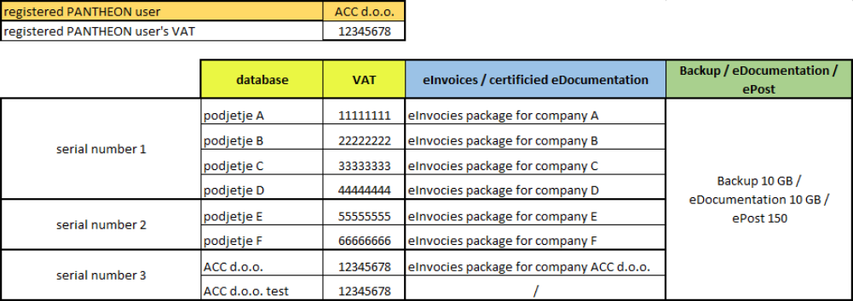
Example for eDocumentation:
PANTHEON user is an accounting service ACC d.o.o. They have 6 different databases for their clients (total eDocumentation space would be 60 GB), 1 production and 1 test database for their business (with total 2 GB of eDocumentation space).
Accounting service ACC d.o.o. orders eDocumentation. They need to have eDocumentation 100 GB package and eDocumentation subscription. When package is activated, an accounting service can use eDocumentation for all databases on all serial numbers.

Slide 7
Example for eInvoices*:
eInvoices package has to be bought separately for companies that would like to use them.
So 6 packages for companies and 1 for ACC d.o.o.
*All counties doesn't have all transactional services. eInvoices and Certified eDocumentation are not available in all countries.

Slide 8
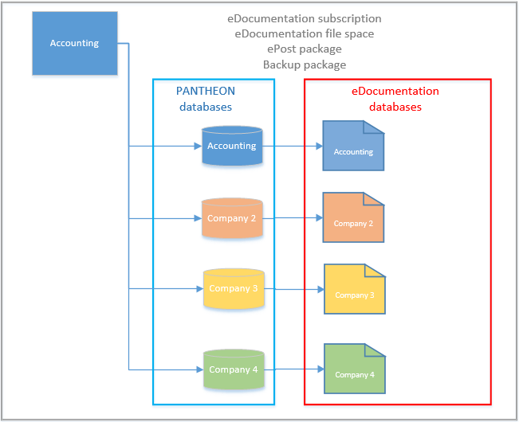
An accounting service company has one eDocumentation subscription and one eDocumentation file space storage in which they store documents for all of their companies.

Slide 9
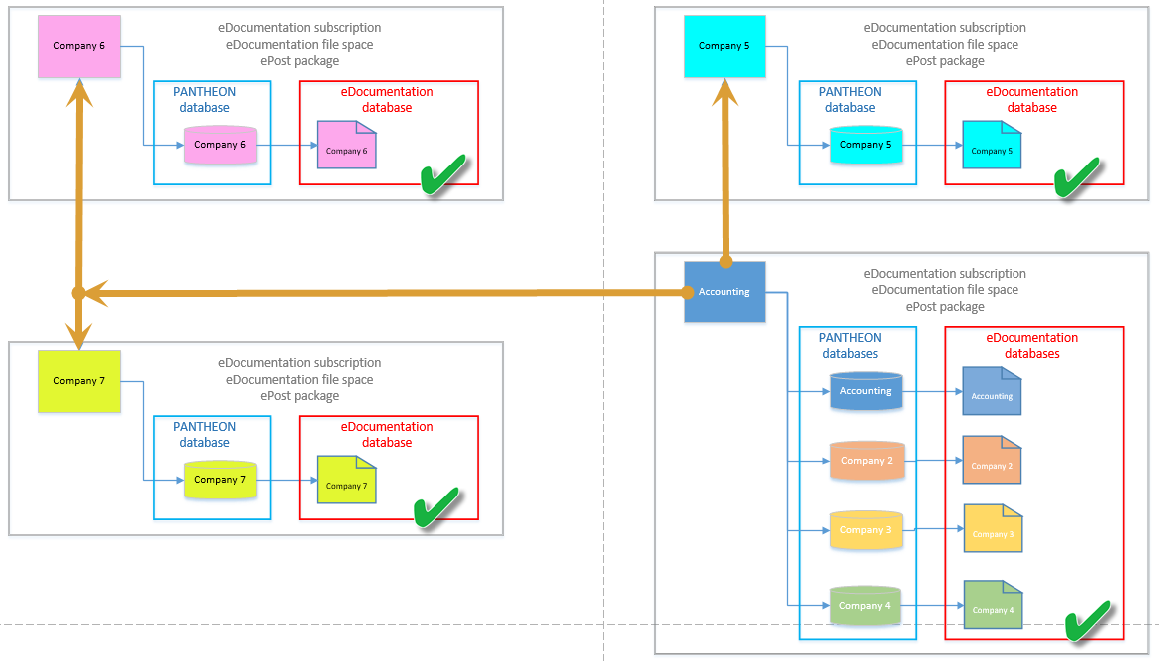

Slide 10
Accounting is using their own PANTHEON license for accessing the databases of Company 5, Company 6 and Company 7.
In case an Accounting company wants to manage documents stored in eDocumentation file space for Company 5, Company 6 and Company 7, all four companies have to have eDocumentation subscription and eDocumentation file space activated.
Stored documents of Company 5/6/7 consume file space from Company 5/6/7.
Stored documents of Accounting company and Company 2/3/4 consume file space from Accounting company.

Slide 11
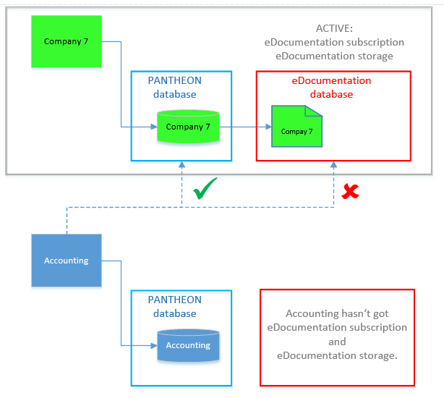
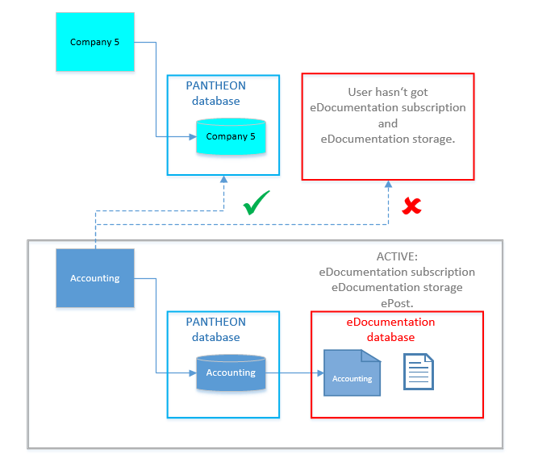
Examples where one or the other doesn‘t have eDocumentation activated:
Company 7 has and an Accounting service doesn‘t have eDocumentation activated. That‘s why, the Accounting service can‘t manage documents for Company 7.
Accounting service has and Company 5 doesn‘t have eDocumentation activated. That‘s why, the Accounting service can‘t manage documents for Company 5.

Slide 12
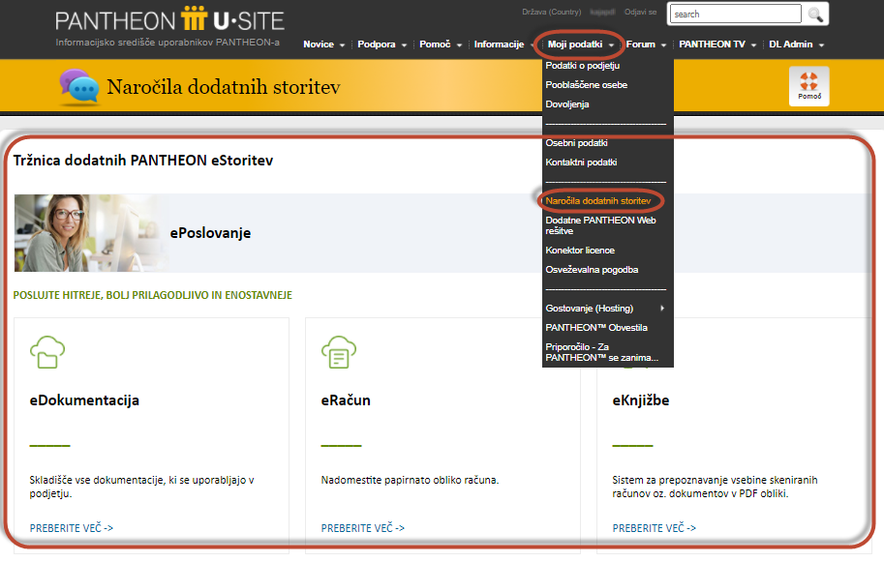
Ordering and activating of Transactional services
PANTHEON users have to login to the Datalab Usersite and go to:
My data -> Order additional services
They can choose from the list of different transactional services.

Slide 13
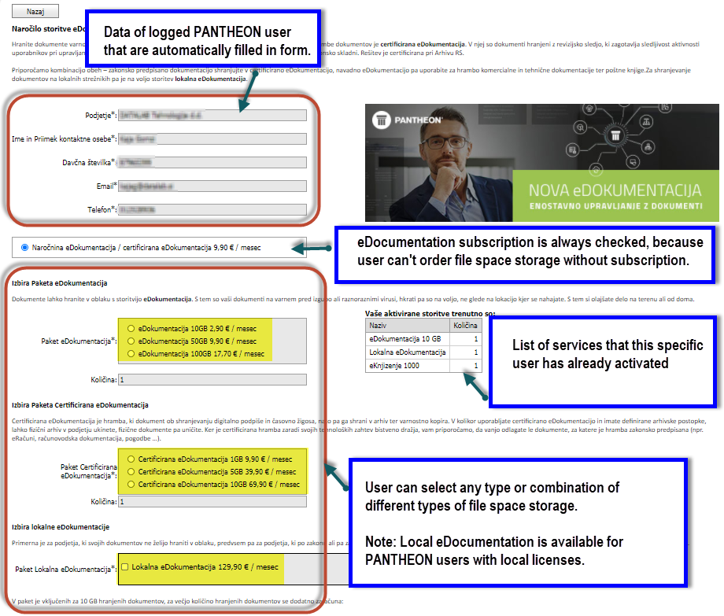
Ordering and activating eDocumentation
Ordering and activating Local eDocumentation is available from PANTHEON X 10.0.20.30 and newer.

Slide 14
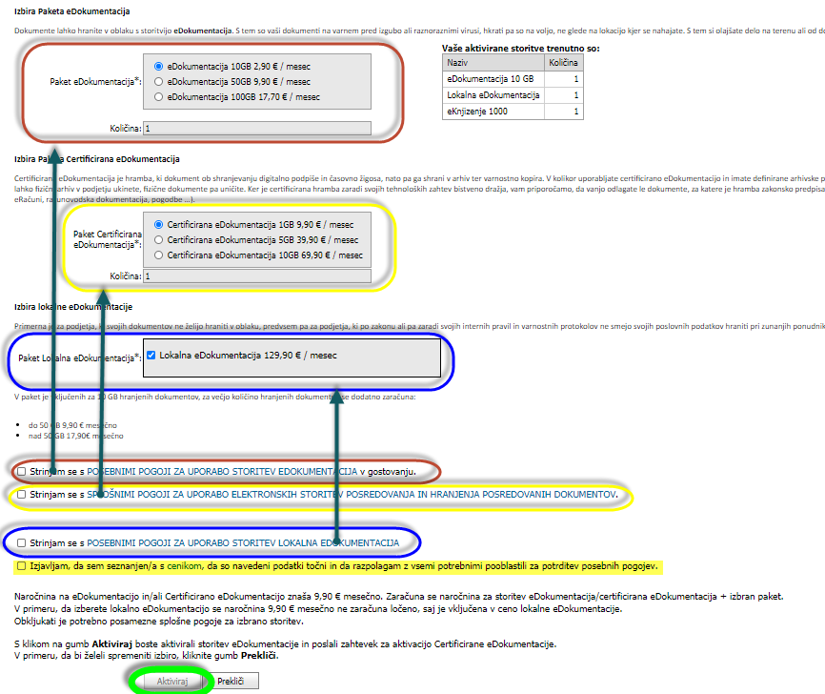
When all terms of use for specific chosen type of file space and confirmation for representative is checked, than user can activate the service by clicking on button „Activate“.

Slide 15
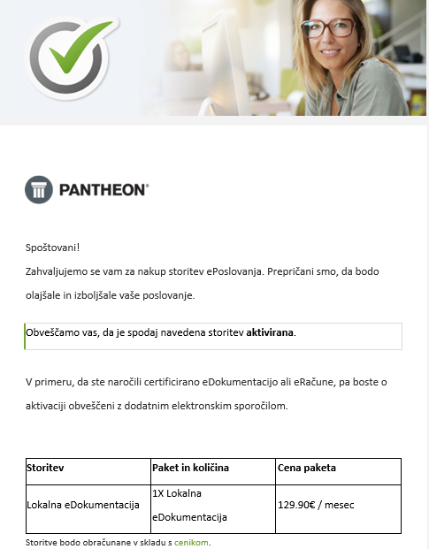
User receives an automatic mail confirmation of activated services.

Slide 16
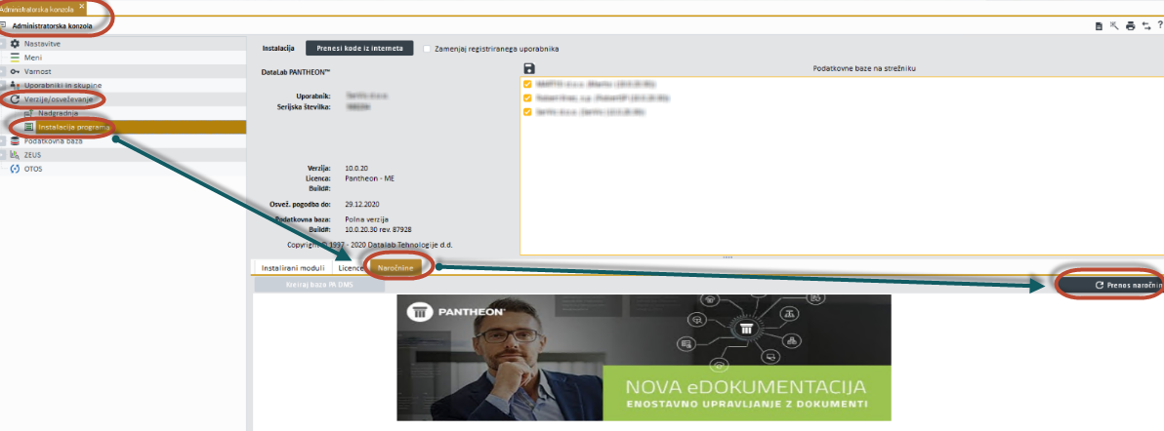
After activating eDocumentation service, user has to download subscription in administrator console and set the right type of storage in classification plan.
Go to: PANTHEON -> Administrator console -> Version/upgrades -> Program installation -> Subscriptions -> Download subscription.

Slide 17
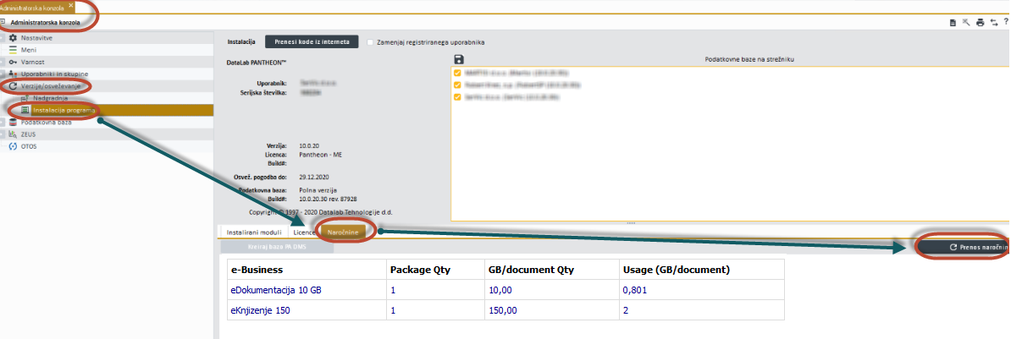
After downloading subscription, user will see activated services and their usage.

Slide 18
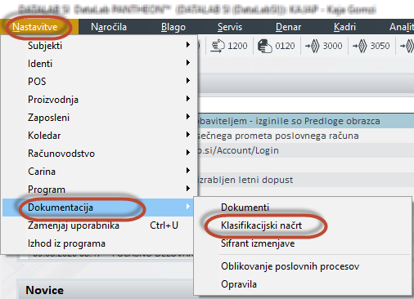
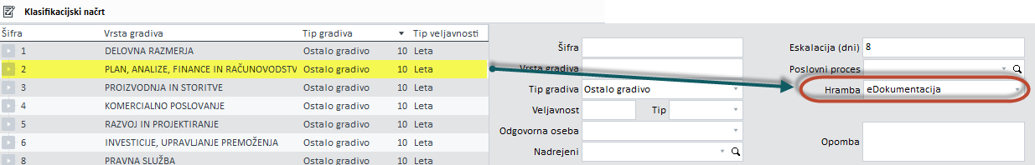
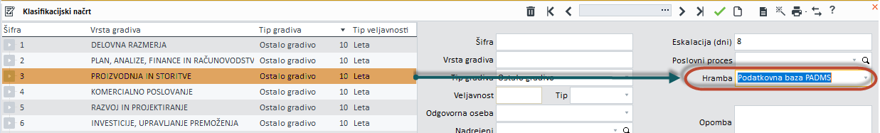
For setting the classification plan go to:
PANTHEON -> Settings -> Documentation -> Classification plan.
User can set different type of storage for specific classification, but only those that are previously activated.

Slide 19
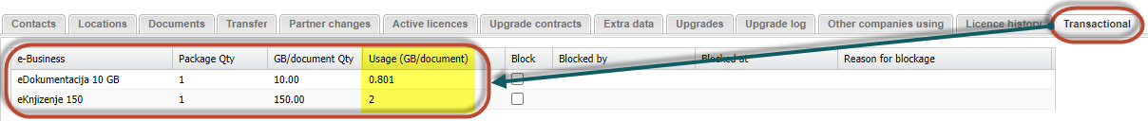
End user details on partnersite
Each partner can check the activated services for their clients on End user details on partnersite.
Go to End user details -> Transactional tab
You can also see the usage of specific service.

Slide 20
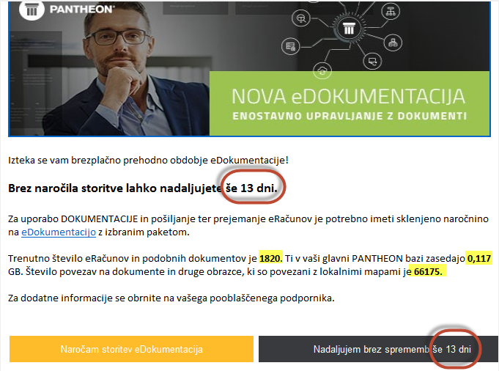
Pop up in PANTHEON
All existing users that upgrades PANTHEON X from version 10.0.17.00 and wants to use documentation services in PANTHEON, have 15 days of transitional period before ordering the service. They have possibility to click on the "Continue without changes" button. After transitional period is over, user receives a pop up only with possibility to order service.
EXAMPLE picture:
The red frames on picture represents dynamic text that is different each day of transition period.
The yellow text is also dynamic.

Slide 21
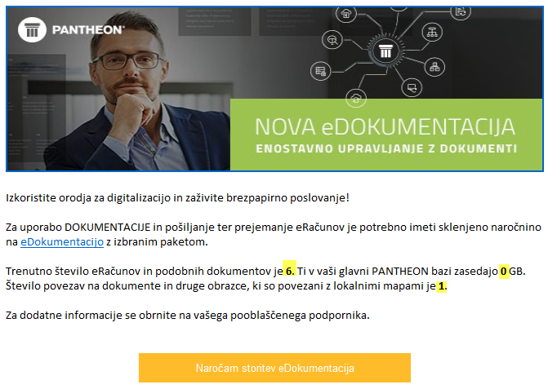
Pop up in PANTHEON
After transitional period passes, user receives pop up only with possibility to order service.
User in this case can‘t use Documentation in PANTHEON but they can see the old documents that are already inserted in PANTHEON database. User can‘t add new documents unless they order eDocumentation service.

Slide 22
Packages and inovicing
Packages with monthly price | Prepaid packages
eDocumentation | ePost
Certified eDocumentation | eInvoices*
Local eDocumentation
eInvoices
Backup
Invoicing monthly packages for
eDocumentation, Local eDocumentation and Backup:
  Local PANTHEON license users:
    the service is invoiced once a year, starting at the end of the month in which service is activated.
    monthly invoice, in case monthly value is higher than 50 EUR + VAT.
  PANTHEON hosting users:
    the service is invoiced every month, starting the next month from the date of activation.
  PANTHEON users with local and hosting licenses:
    the service is invoiced every month, starting the next month from the date of activation.
Invoicing for prepaid ePost packages:
  Prepaid packages are invoiced within the month of activation, no matter if company is local or hosting PANTHEON user.
Invoicing for eInvoices and Certified eDocumentation may vary in each country due to different local providers.

Slide 23
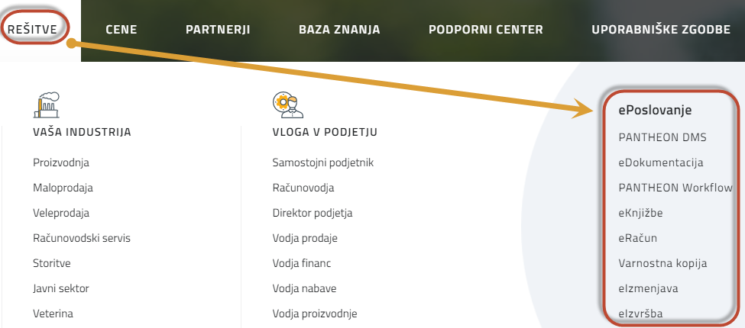
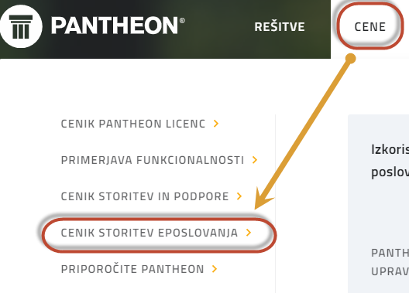
Information and prices
For more information visit Datalab local web page: https://www.datalab.xx Go to Solutions -> eBusiness
For price list visit Datalab local web page: https://www.datalab.xx Go to Prices -> price list of e-business services

